Slide 1
CLASSIFICATION: ALTERNATIVE TECHNIQUES
Md. Fazlul Karim Patwary
IIT

Slide 2
Rule-Based Classifier
Classify records by using a collection of “if…then…” rules
Rule: (Condition) → y
  where
    Condition is a conjunctions of attributes
    y is the class label
  Examples of classification rules:
    (Blood Type=Warm) ∧ (Lay Eggs=Yes) → Birds
    (Taxable Income < 50K) ∧ (Refund=Yes) → Evade=No

Slide 3
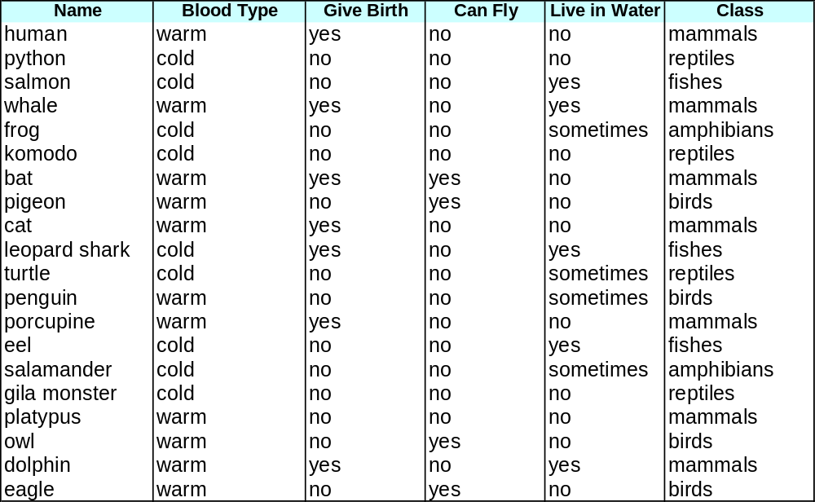
Rule-based Classifier (Example)
R1: (Give Birth = no) ∧ (Can Fly = yes) → Birds
R2: (Give Birth = no) ∧ (Live in Water = yes) → Fishes
R3: (Give Birth = yes) ∧ (Blood Type = warm) → Mammals
R4: (Give Birth = no) ∧ (Can Fly = no) → Reptiles
R5: (Live in Water = sometimes) → Amphibians

Slide 4
Application of Rule-Based Classifier
A rule r covers an instance x if the attributes of the instance satisfy the condition of the rule
R1: (Give Birth = no) ∧ (Can Fly = yes) → Birds
R2: (Give Birth = no) ∧ (Live in Water = yes) → Fishes
R3: (Give Birth = yes) ∧ (Blood Type = warm) → Mammals
R4: (Give Birth = no) ∧ (Can Fly = no) → Reptiles
R5: (Live in Water = sometimes) → Amphibians
The rule R1 covers a hawk => Bird
The rule R3 covers the grizzly bear => Mammal

Slide 5
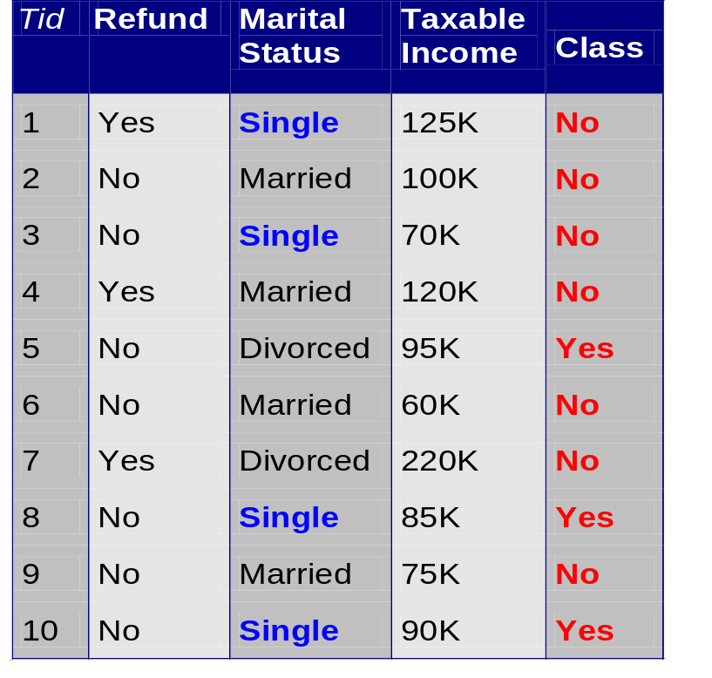
Rule Coverage and Accuracy
Coverage of a rule:
  Fraction of records that satisfy the antecedent of a rule
Accuracy of a rule:
  Fraction of records that satisfy both the antecedent and consequent of a rule
(Status=Single) → No
Coverage = 40%, Accuracy = 50%

Slide 6
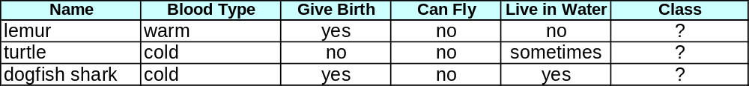
How does Rule-based Classifier Work?
R1: (Give Birth = no) ∧ (Can Fly = yes) → Birds
R2: (Give Birth = no) ∧ (Live in Water = yes) → Fishes
R3: (Give Birth = yes) ∧ (Blood Type = warm) → Mammals
R4: (Give Birth = no) ∧ (Can Fly = no) → Reptiles
R5: (Live in Water = sometimes) → Amphibians
A lemur triggers rule R3, so it is classified as a mammal
A turtle triggers both R4 and R5
A dogfish shark triggers none of the rules

Slide 7
Characteristics of Rule-Based Classifier
Mutually exclusive rules
  Classifier contains mutually exclusive rules if the rules are independent of each other
  Every record is covered by at most one rule
Exhaustive rules
  Classifier has exhaustive coverage if it accounts for every possible combination of attribute values
  Each record is covered by at least one rule

Slide 8
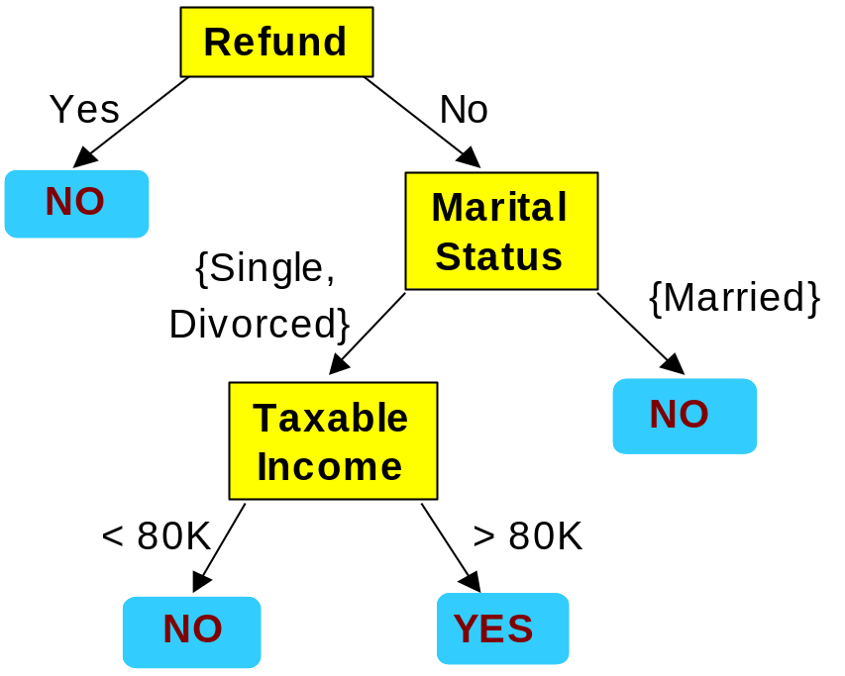
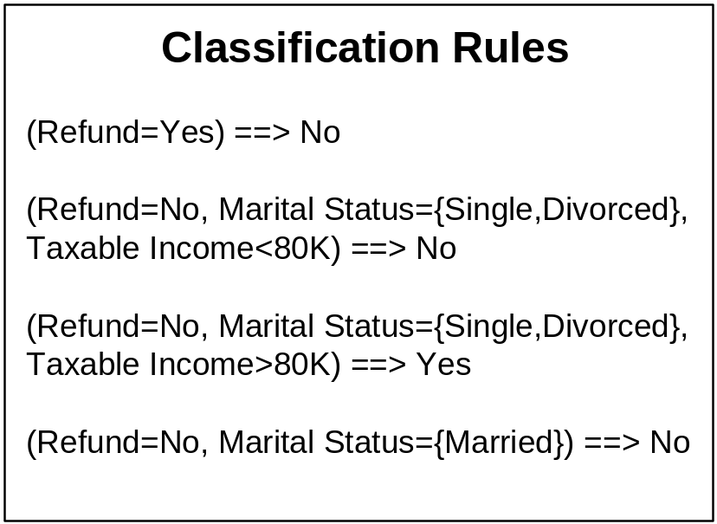
From Decision Trees To Rules
Rules are mutually exclusive and exhaustive
Rule set contains as much information as the tree

Slide 9
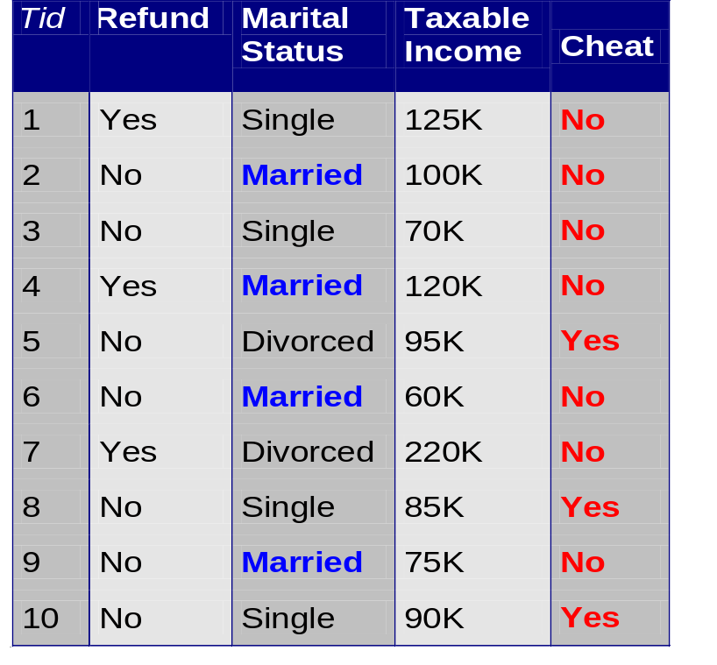
Rules Can Be Simplified
Initial Rule: (Refund=No) ∧ (Status=Married) → No
Simplified Rule: (Status=Married) → No

Slide 10
Ordered Rule Set
Rules are rank ordered according to their priority
  An ordered rule set is known as a decision list
When a test record is presented to the classifier
  It is assigned to the class label of the highest ranked rule it has triggered
  If none of the rules fired, it is assigned to the default class
R1: (Give Birth = no) ∧ (Can Fly = yes) → Birds
R2: (Give Birth = no) ∧ (Live in Water = yes) → Fishes
R3: (Give Birth = yes) ∧ (Blood Type = warm) → Mammals
R4: (Give Birth = no) ∧ (Can Fly = no) → Reptiles
R5: (Live in Water = sometimes) → Amphibians

Slide 11
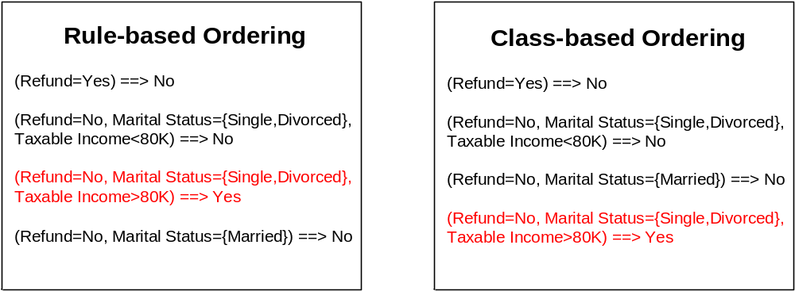
Rule Ordering Schemes
Rule-based ordering
  Individual rules are ranked based on their quality
Class-based ordering
  Rules that belong to the same class appear together

Slide 12
Building Classification Rules
Direct Method:
    Extract rules directly from data
    e.g.: RIPPER, CN2, Holte’s 1R
Indirect Method:
    Extract rules from other classification models (e.g.
    decision trees, neural networks, etc).
    e.g: C4.5rules

Slide 13
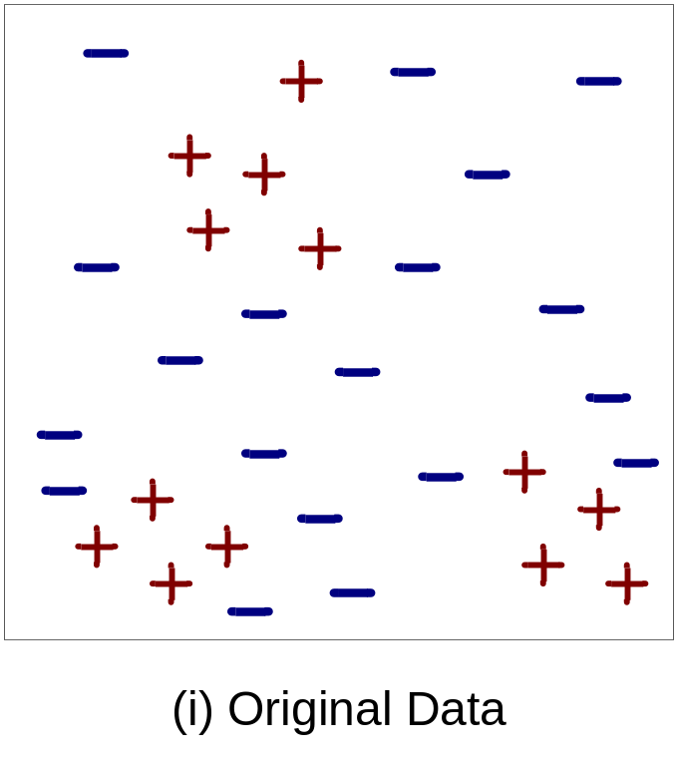
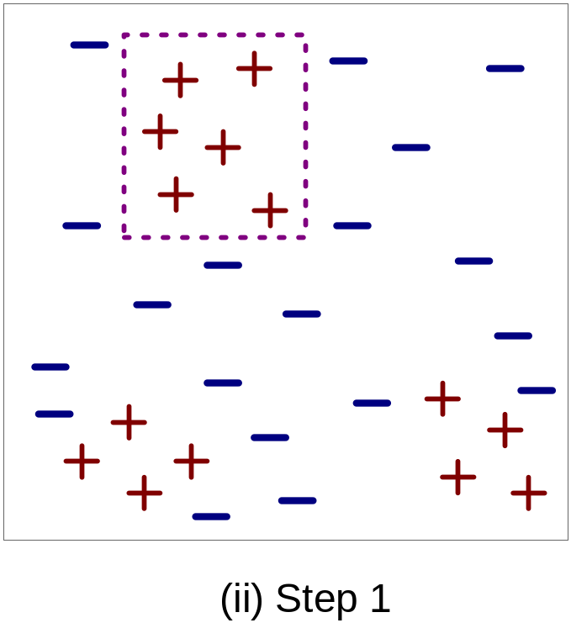
Example of Sequential Covering

Slide 14
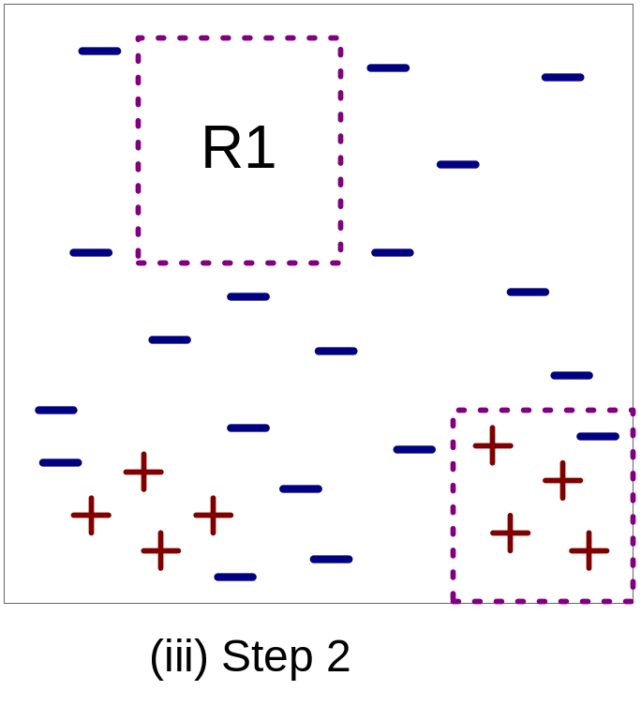
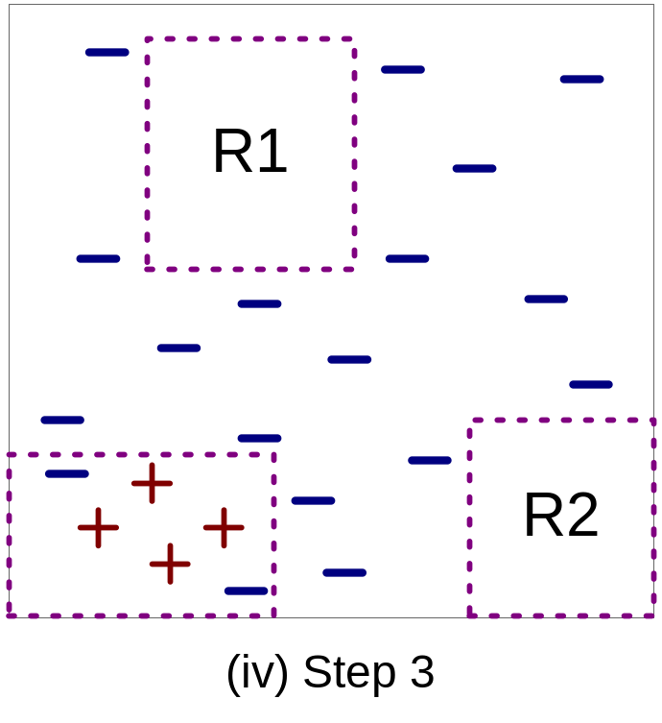
Example of Sequential Covering…

Slide 15
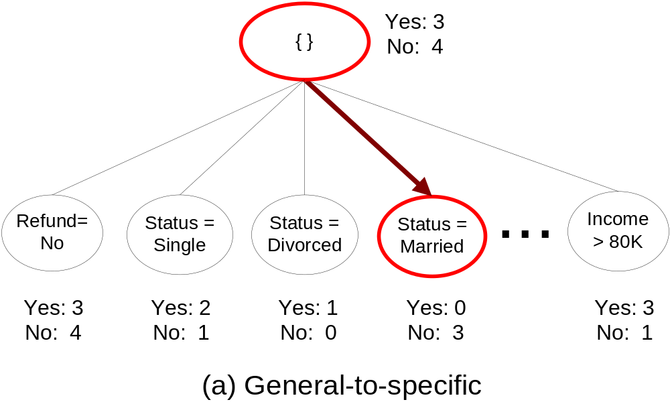
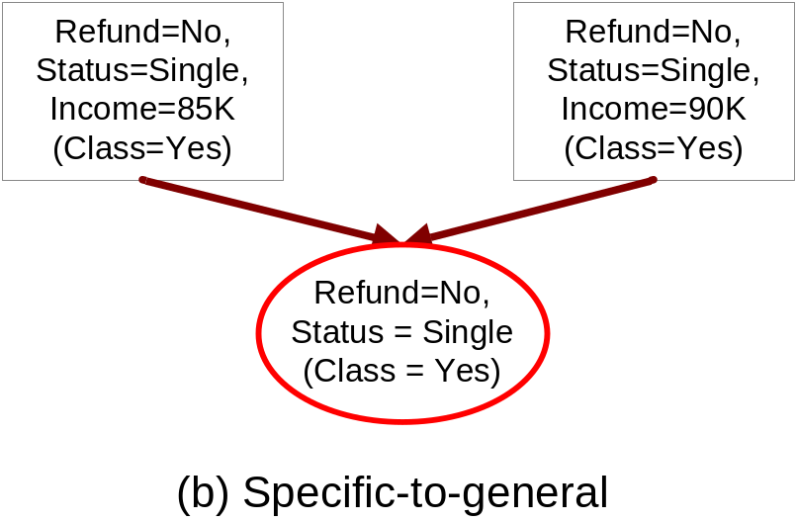
Rule Growing
Two common strategies

Slide 16
Rule Growing (Examples)
RIPPER Algorithm:
  Start from an empty rule: {} => class
  Add conjuncts that maximizes FOIL’s information gain measure:
    R0: {} => class (initial rule)
    R1: {A} => class (rule after adding conjunct)
    Gain(R0, R1) = t [ log (p1/(p1+n1)) – log (p0/(p0 + n0)) ]
    where t: number of positive instances covered by both R0 and R1
    p0: number of positive instances covered by R0
    n0: number of negative instances covered by R0
    p1: number of positive instances covered by R1
    n1: number of negative instances covered by R1

Slide 17
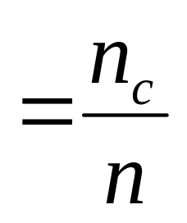
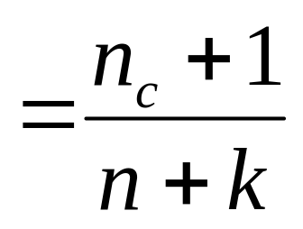
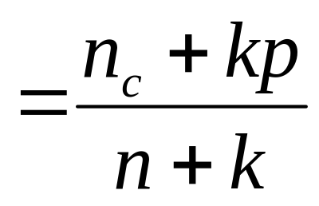
Rule Evaluation
Metrics:
  Accuracy
  Laplace
  M-estimate
n : Number of instances covered by rule
n_{c} : Number of instances covered by rule
k : Number of classes
p : Prior probability

Slide 18
Direct Method: RIPPER
For 2-class problem, choose one of the classes as positive class, and the other as negative class
  Learn rules for positive class
  Negative class will be default class
For multi-class problem
  Order the classes according to increasing class prevalence (fraction of instances that belong to a particular class)
  Learn the rule set for smallest class first, treat the rest as negative class
  Repeat with next smallest class as positive class

Slide 19
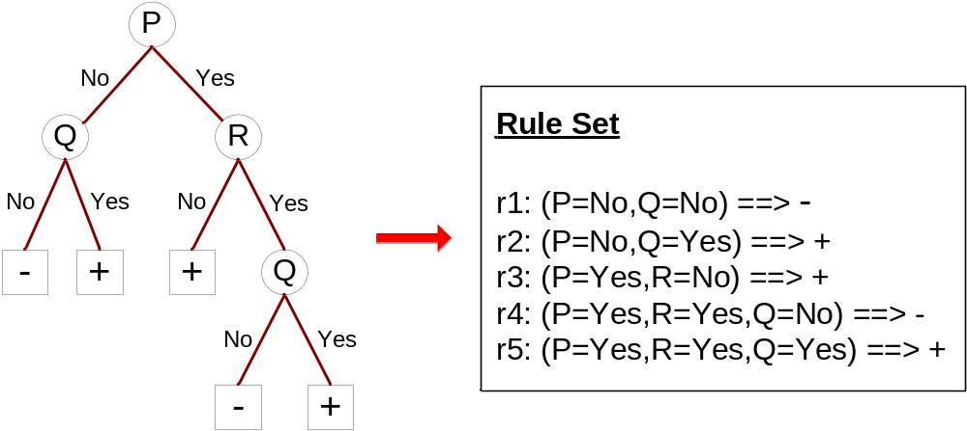
Indirect Methods

Slide 20
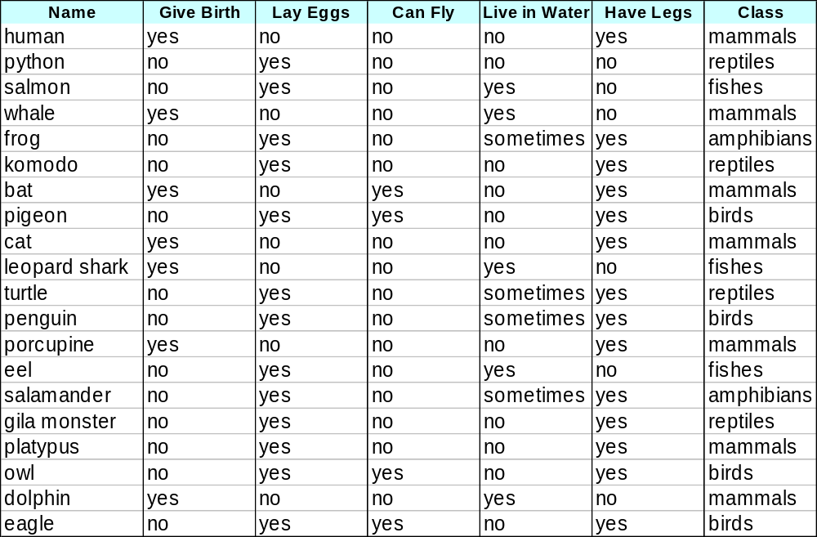
Example

Slide 21
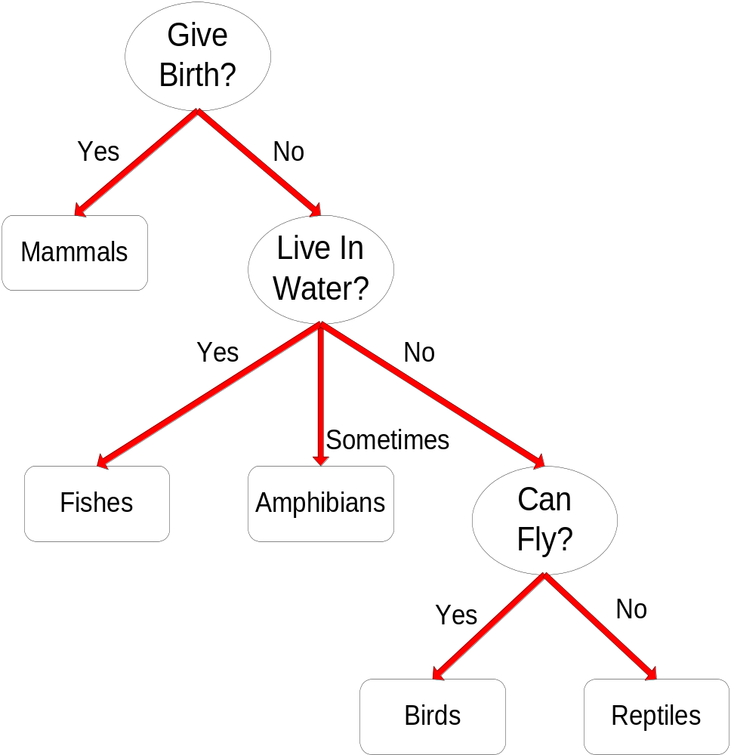
C4.5 versus C4.5rules versus RIPPER
C4.5rules:
(Give Birth=No, Can Fly=Yes) → Birds
(Give Birth=No, Live in Water=Yes) → Fishes
(Give Birth=Yes) → Mammals
(Give Birth=No, Can Fly=No, Live in Water=No) → Reptiles
( ) → Amphibians
RIPPER:
(Live in Water=Yes) → Fishes
(Have Legs=No) → Reptiles
(Give Birth=No, Can Fly=No, Live In Water=No)
→ Reptiles
(Can Fly=Yes,Give Birth=No) → Birds
() → Mammals

Slide 22
Advantages of Rule-Based Classifiers
As highly expressive as decision trees
Easy to interpret
Easy to generate
Can classify new instances rapidly
Performance comparable to decision trees

Slide 23
Instance Based Classifiers
Examples:
  Rote-learner
    Memorizes entire training data and performs classification only if attributes of record match one of the training examples exactly
  Nearest neighbor
    Uses k “closest” points (nearest neighbors) for performing classification

Slide 24






Nearest Neighbor Classifiers
Basic idea:
  If it walks like a duck, quacks like a duck, then it’s probably a duck
Compute Distance
Test Record
Training Records
Choose k of the “nearest” records

Slide 25
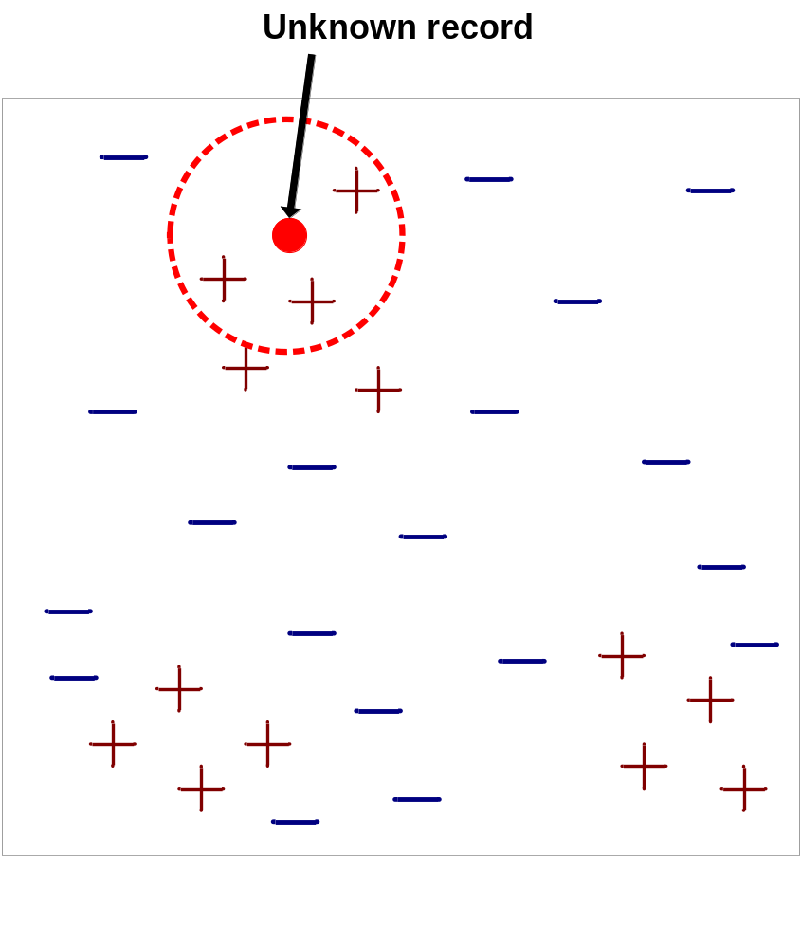
Nearest-Neighbor Classifiers
Requires three things
  The set of stored records
  Distance Metric to compute distance between records
  The value of k, the number of nearest neighbors to retrieve
To classify an unknown record:
  Compute distance to other training records
  Identify k nearest neighbors
  Use class labels of nearest neighbors to determine the class label of unknown record (e.g., by taking majority vote)

Slide 26

Definition of Nearest Neighbor
K-nearest neighbors of a record x are data points that have the k smallest distance to x

Slide 27
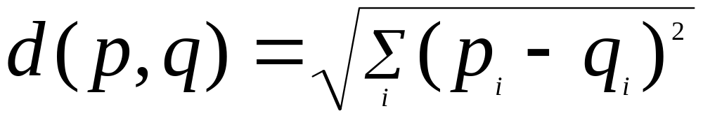
Nearest Neighbor Classification
Compute distance between two points:
  Euclidean distance
Determine the class from nearest neighbor list
  take the majority vote of class labels among the k-nearest neighbors
  Weigh the vote according to distance
    weight factor, w = 1/d²

Slide 28
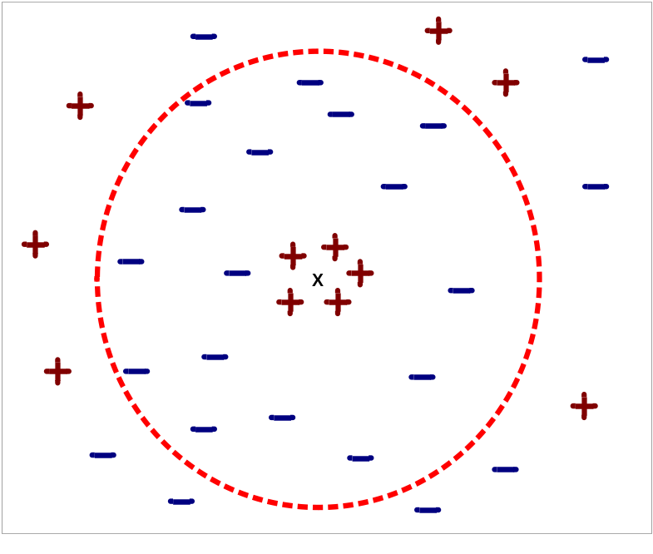
Nearest Neighbor Classification…
Choosing the value of k:
  If k is too small, sensitive to noise points
  If k is too large, neighborhood may include points from other classes

Slide 29
Nearest neighbor Classification…
k-NN classifiers are lazy learners
  It does not build models explicitly
  Unlike eager learners such as decision tree induction and rule-based systems
  Classifying unknown records are relatively expensive

Slide 30
Example: PEBLS
PEBLS: Parallel Examplar-Based Learning System (Cost & Salzberg)
  Works with both continuous and nominal features
    For nominal features, distance between two nominal values is computed using modified value difference metric (MVDM)
  Each record is assigned a weight factor
  Number of nearest neighbor, k = 1

Slide 31

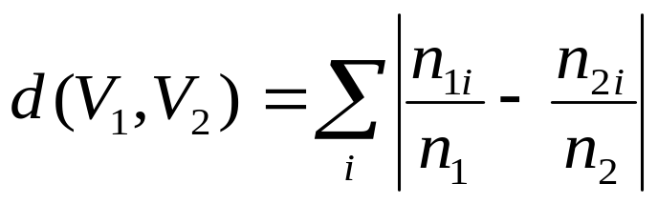
Example: PEBLS
Distance between nominal attribute values:
d(Single,Married)
= | 2/4 – 0/4 | + | 2/4 – 4/4 | = 1
d(Single,Divorced)
= | 2/4 – 1/2 | + | 2/4 – 1/2 | = 0
d(Married,Divorced)
= | 0/4 – 1/2 | + | 4/4 – 1/2 | = 1
d(Refund=Yes,Refund=No)
= | 0/3 – 3/7 | + | 3/3 – 4/7 | = 6/7
Class | Marital Status
 | Single | Married | Divorced
Yes | 2 | 0 | 1
No | 2 | 4 | 1
Class | Refund
 | Yes | No
Yes | 0 | 3
No | 3 | 4

Slide 32
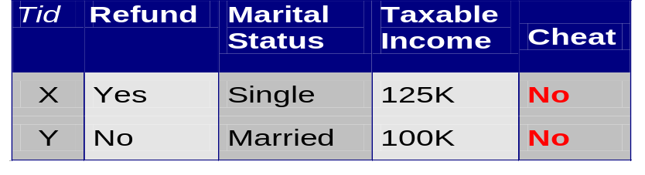
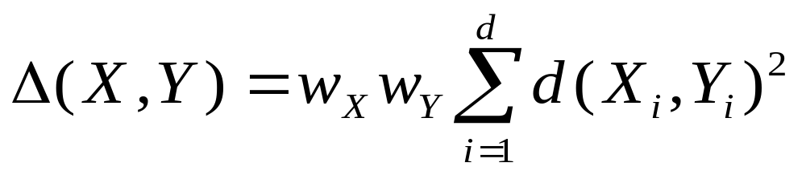
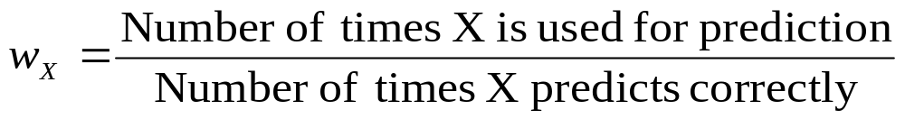
Example: PEBLS
Distance between record X and record Y:
where:
w_{X} ≅ 1 if X makes accurate prediction most of the time
w_{X} > 1 if X is not reliable for making predictions

Slide 33
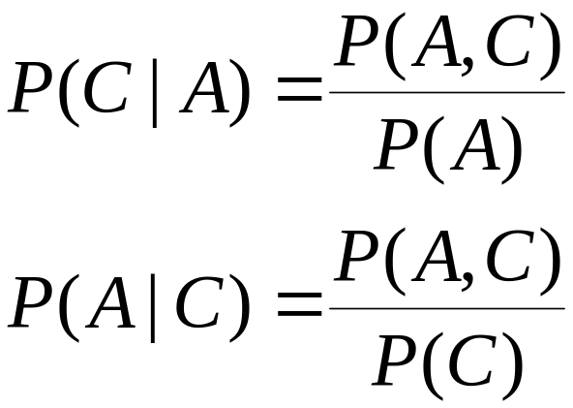
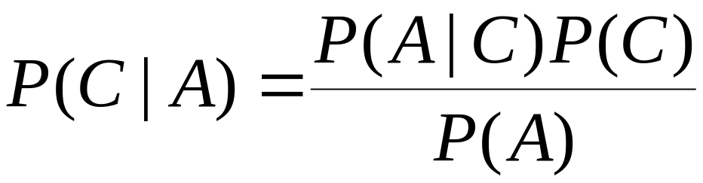
Bayes Classifier
A probabilistic framework for solving classification problems
Conditional Probability:
Bayes theorem:

Slide 34
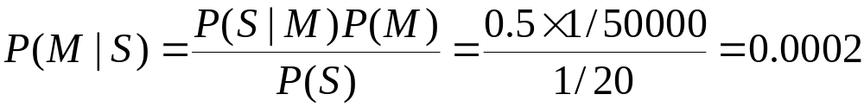
Example of Bayes Theorem
Given:
  A doctor knows that meningitis causes stiff neck 50% of the time
  Prior probability of any patient having meningitis is 1/50,000
  Prior probability of any patient having stiff neck is 1/20
If a patient has stiff neck, what’s the probability he/she has meningitis?

Slide 35
Bayesian Classifiers
Consider each attribute and class label as random variables
Given a record with attributes (A₁, A₂,…,A_{n})
  Goal is to predict class C
  Specifically, we want to find the value of C that maximizes P(C| A₁, A₂,…,A_{n} )
Can we estimate P(C| A₁, A₂,…,A_{n} ) directly from data?

Slide 36
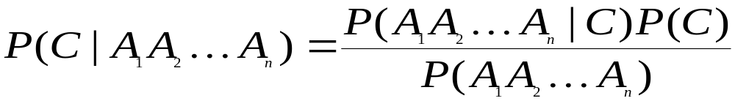
Bayesian Classifiers
Approach:
  compute the posterior probability P(C | A₁, A₂, …, A_{n}) for all values of C using the Bayes theorem
  Choose value of C that maximizes
  P(C | A₁, A₂, …, A_{n})
  Equivalent to choosing value of C that maximizes
  P(A₁, A₂, …, A_{n}|C) P(C)
How to estimate P(A₁, A₂, …, A_{n} | C )?

Slide 37
Naïve Bayes Classifier
Assume independence among attributes A_{i} when class is given:
  P(A₁, A₂, …, A_{n} |C) = P(A₁| C_{j}) P(A₂| C_{j})… P(A_{n}| C_{j})
  Can estimate P(A_{i}| C_{j}) for all A_{i} and C_{j}.
  New point is classified to C_{j} if P(C_{j}) Π P(A_{i}| C_{j}) is maximal.

Slide 38
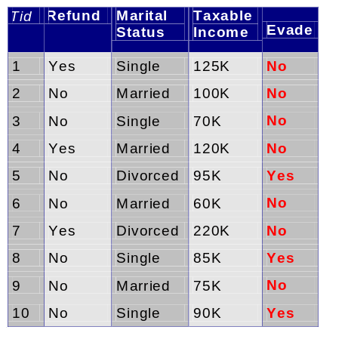
How to Estimate Probabilities from Data?
Class: P(C) = N_{c}/N
  e.g., P(No) = 7/10,
  P(Yes) = 3/10
For discrete attributes:
P(A_{i} | C_{k}) = |A_{ik}|/ N_{c}
  where |A_{ik}| is number of instances having attribute A_{i} and belongs to class C_{k}
  Examples:
  P(Status=Married|No) = 4/7
  P(Refund=Yes|Yes)=0
k

Slide 39
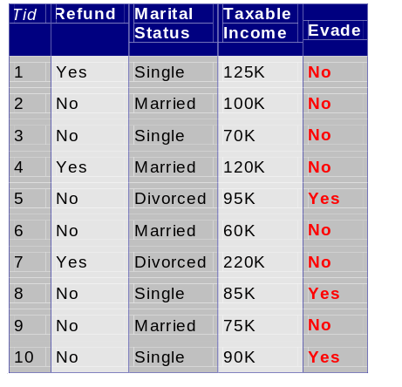
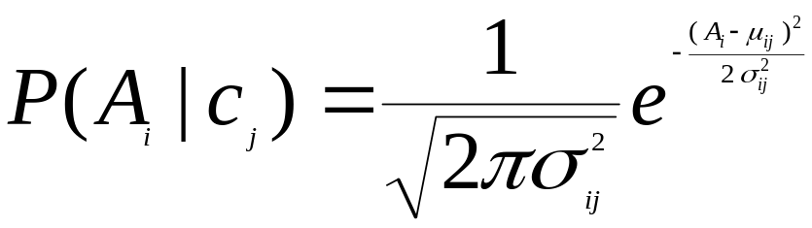
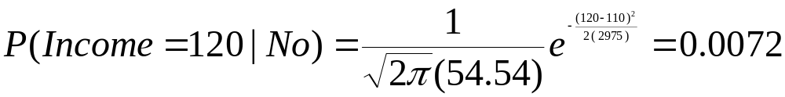
How to Estimate Probabilities from Data?
Normal distribution:
  One for each (A_{i},c_{i}) pair
For (Income, Class=No):
  If Class=No
    sample mean = 110
    sample variance = 2975

Slide 40
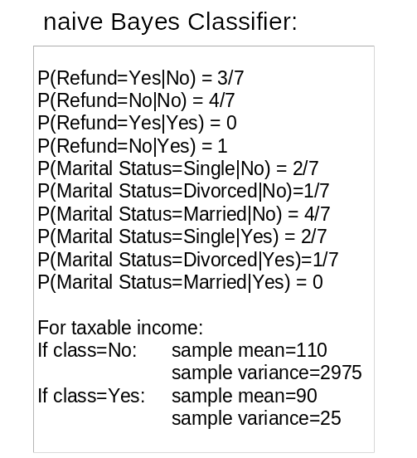
Example of Naïve Bayes Classifier
Given a Test Record:
P(X|Class=No) = P(Refund=No|Class=No)
× P(Married| Class=No)
× P(Income=120K| Class=No)
= 4/7 × 4/7 × 0.0072 = 0.0024
P(X|Class=Yes) = P(Refund=No| Class=Yes)
× P(Married| Class=Yes)
× P(Income=120K| Class=Yes)
= 1 × 0 × 1.2 × 10⁻⁹ = 0
Since P(X|No)P(No) > P(X|Yes)P(Yes)
Therefore P(No|X) > P(Yes|X)
=> Class = No

Slide 41
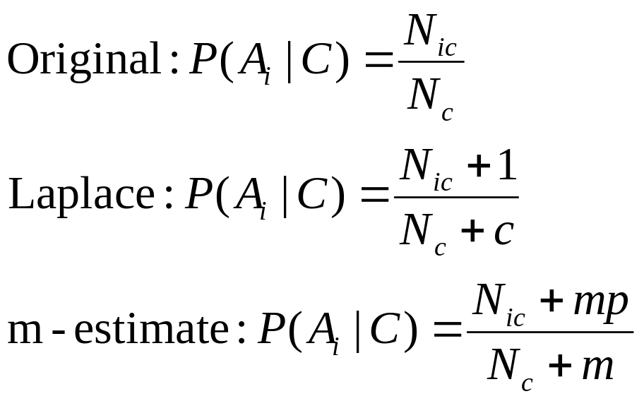
Naïve Bayes Classifier
If one of the conditional probability is zero, then the entire expression becomes zero
Probability estimation:
c: number of classes
p: prior probability
m: parameter

Slide 42
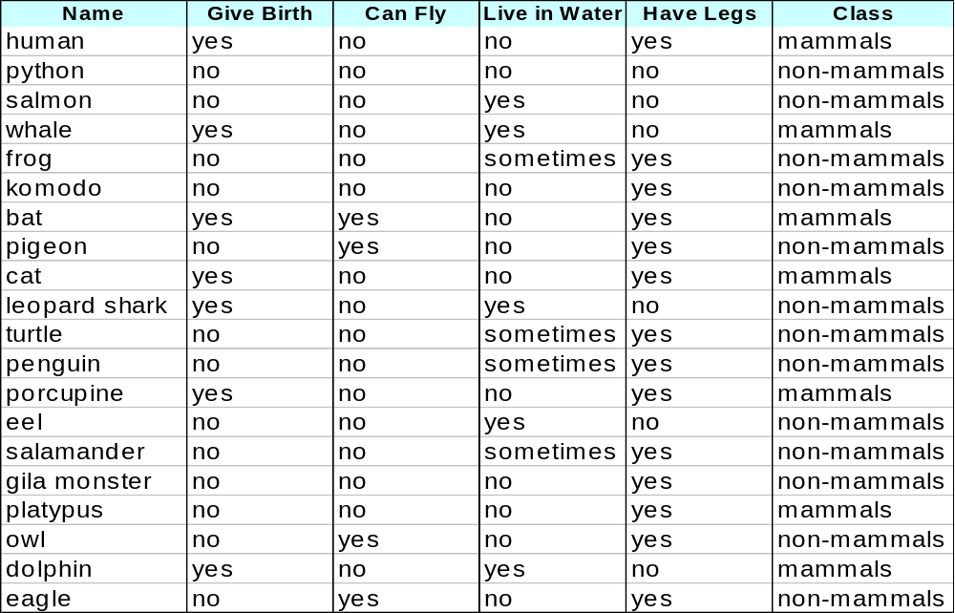
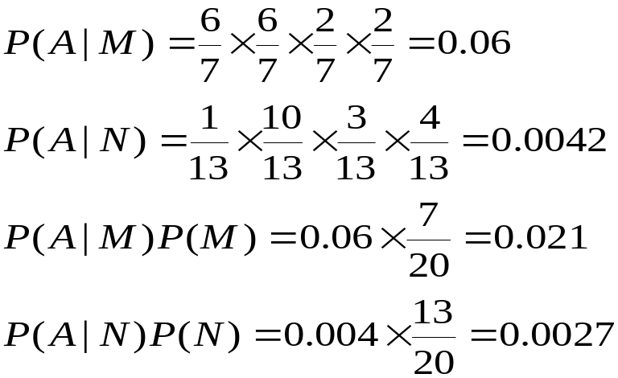
Example of Naïve Bayes Classifier
A: attributes
M: mammals
N: non-mammals
P(A|M)P(M) > P(A|N)P(N)
=> Mammals

Slide 43
Naïve Bayes (Summary)
Robust to isolated noise points
Handle missing values by ignoring the instance during probability estimate calculations
Robust to irrelevant attributes
Independence assumption may not hold for some attributes
  Use other techniques such as Bayesian Belief Networks (BBN)

Slide 44
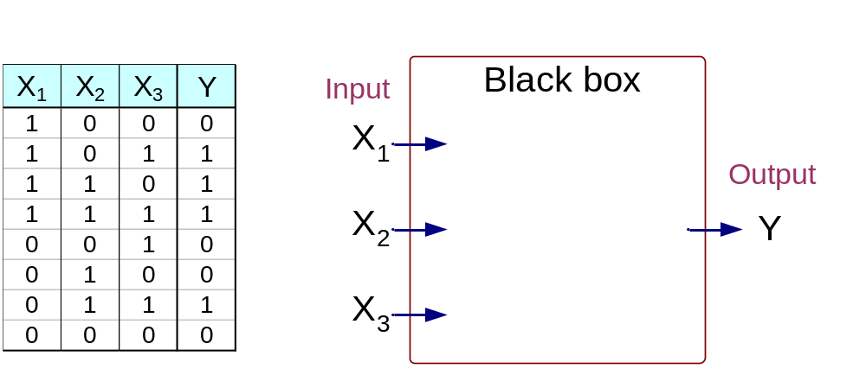
Artificial Neural Networks (ANN)
Output Y is 1 if at least two of the three inputs are equal to 1.

Slide 45
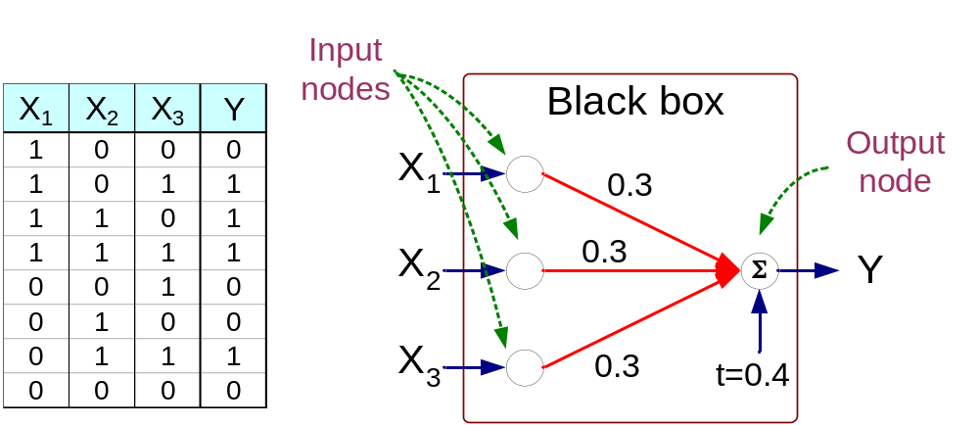
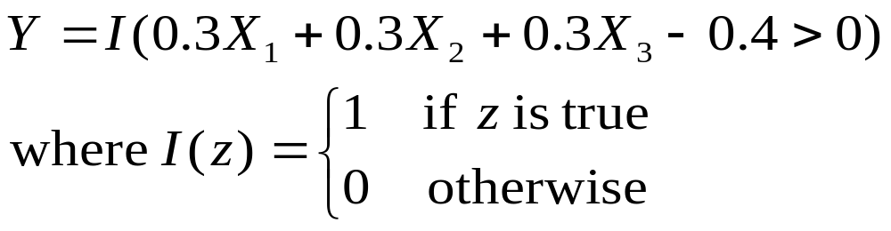
Artificial Neural Networks (ANN)

Slide 46
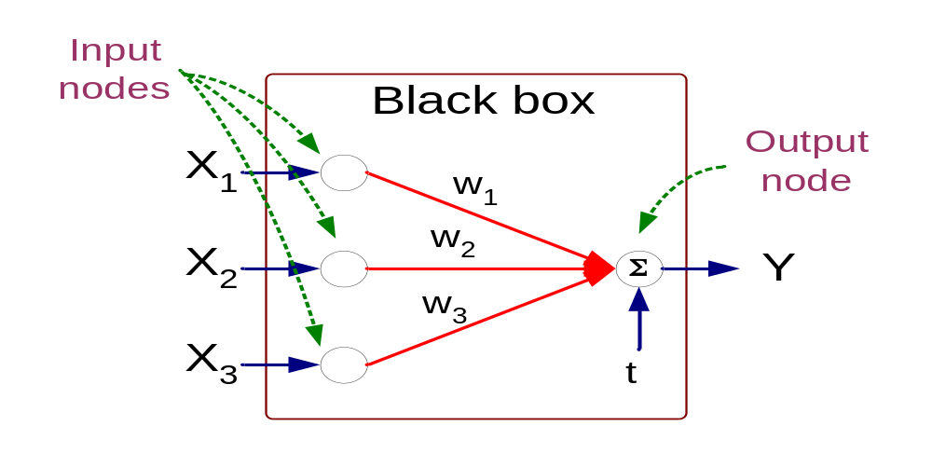
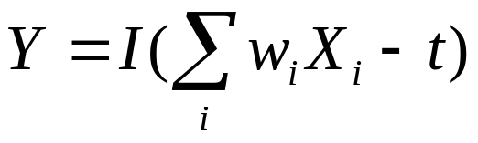
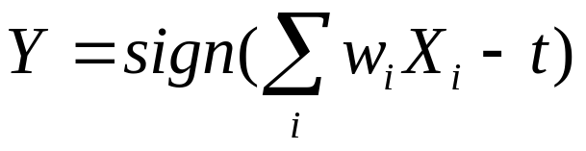
Artificial Neural Networks (ANN)
Model is an assembly of inter-connected nodes and weighted links
Output node sums up each of its input value according to the weights of its links
Compare output node against some threshold t
Perceptron Model
or

Slide 47
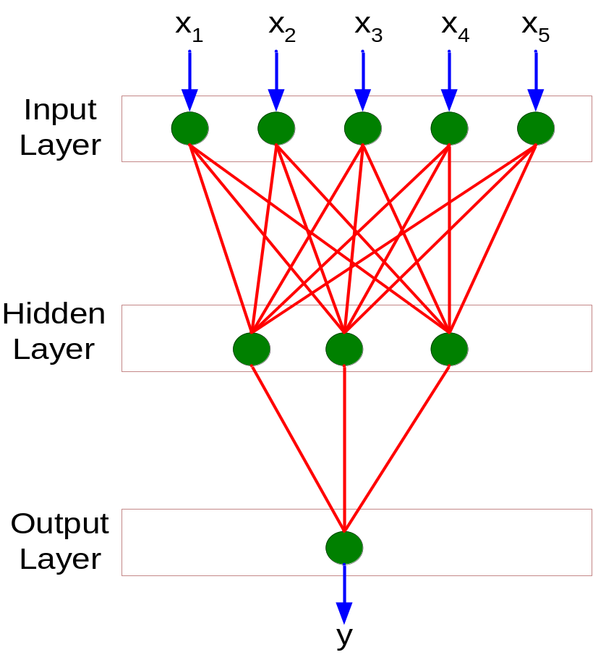
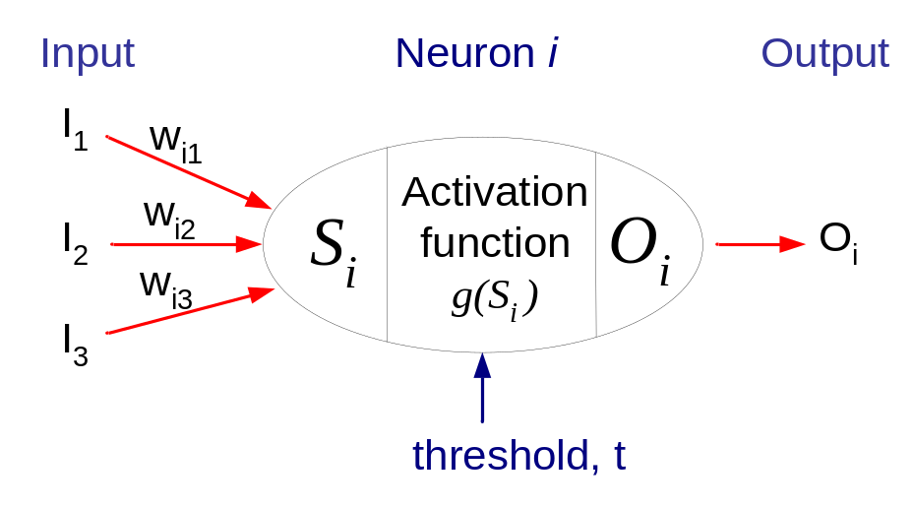
General Structure of ANN
Training ANN means learning the weights of the neurons

Slide 48
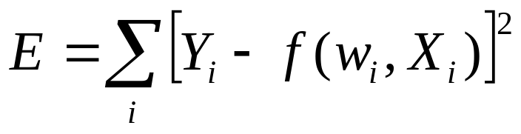
Algorithm for learning ANN
Initialize the weights (w₀, w₁, …, w_{k})
Adjust the weights in such a way that the output of ANN is consistent with class labels of training examples
  Objective function:
  Find the weights w_{i}’s that minimize the above objective function
    e.g., backpropagation algorithm

Slide 49
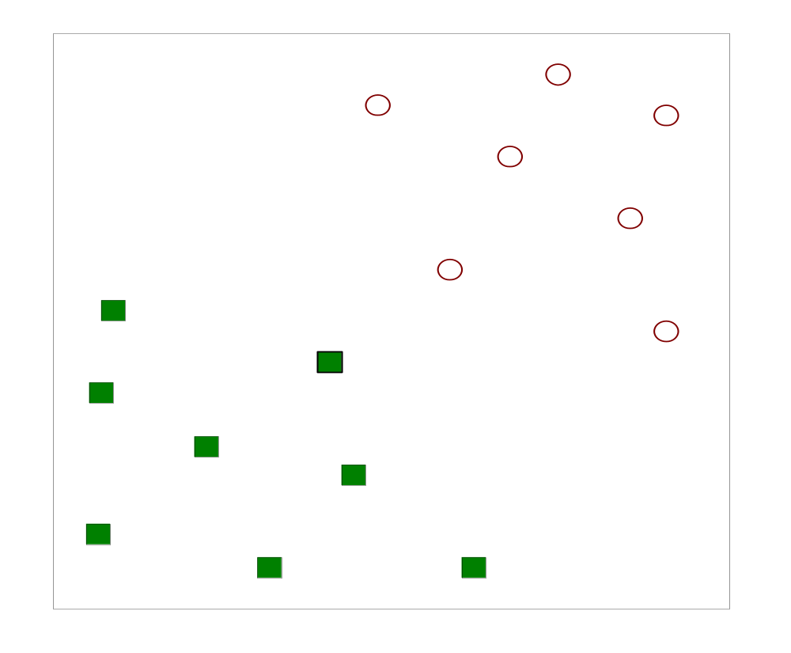
Support Vector Machines
Find a linear hyperplane (decision boundary) that will separate the data

Slide 50
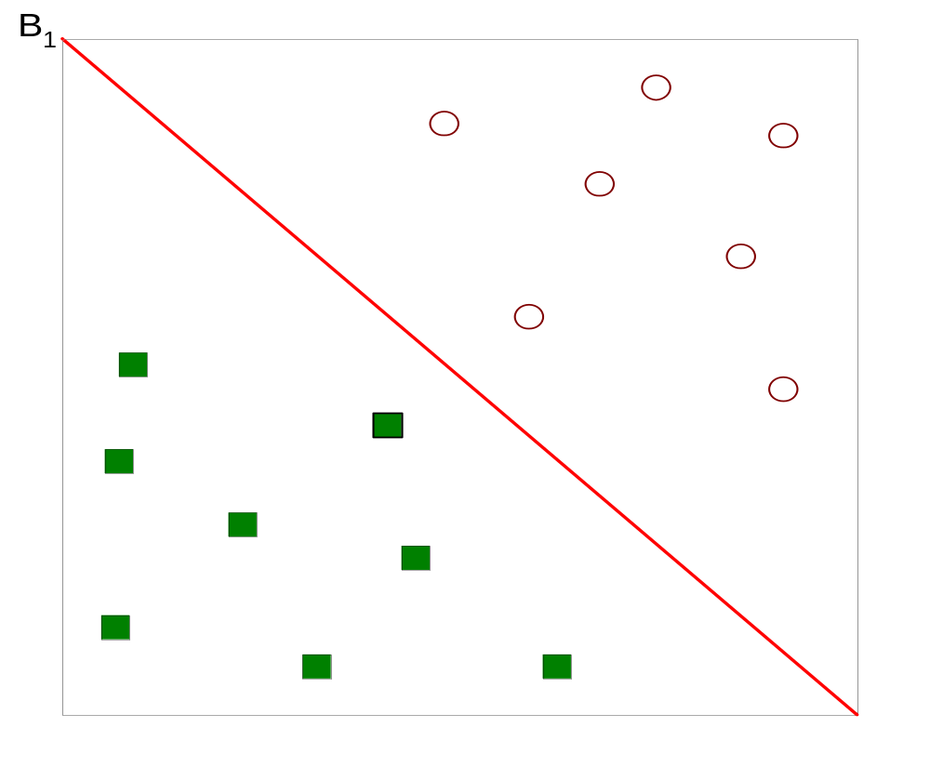
Support Vector Machines
One Possible Solution

Slide 51
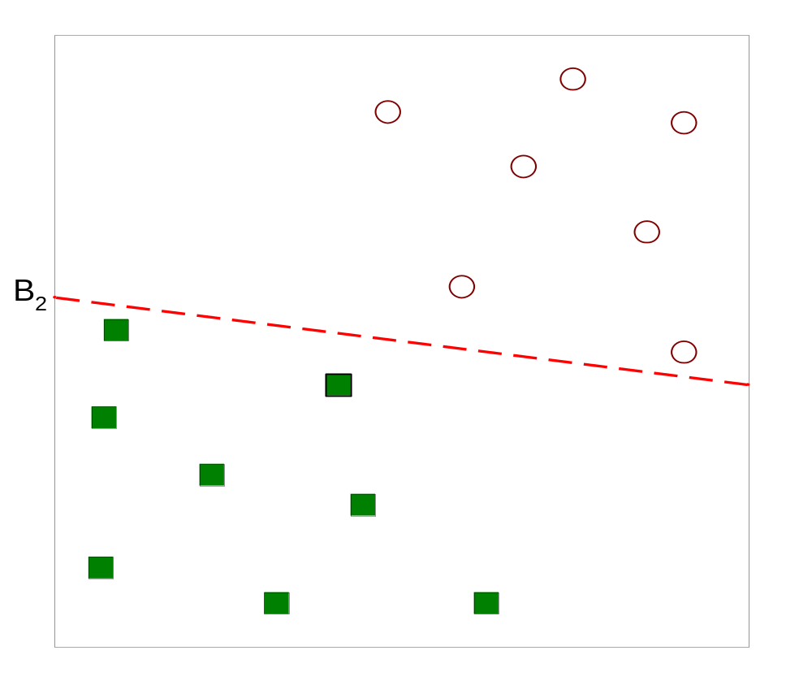
Support Vector Machines
Another possible solution

Slide 52
Support Vector Machines
Other possible solutions

Slide 53

Support Vector Machines
Which one is better? B1 or B2?
How do you define better?

Slide 54

Support Vector Machines
Find hyperplane maximizes the margin => B1 is better than B2

Slide 55






Support Vector Machines

Slide 56


Support Vector Machines
We want to maximize:
  Which is equivalent to minimizing:
  But subjected to the following constraints:
    This is a constrained optimization problem
      Numerical approaches to solve it (e.g., quadratic programming)

Slide 57

Nonlinear Support Vector Machines
What if decision boundary is not linear?

Slide 58

Nonlinear Support Vector Machines
Transform data into higher dimensional space

Slide 59
Ensemble Methods
Construct a set of classifiers from the training data
Predict class label of previously unseen records by aggregating predictions made by multiple classifiers

Slide 60

General Idea

Slide 61

Why does it work?
Suppose there are 25 base classifiers
  Each classifier has error rate, ε = 0.35
  Assume classifiers are independent
  Probability that the ensemble classifier makes a wrong prediction:

Slide 62
Examples of Ensemble Methods
How to generate an ensemble of classifiers?
  Bagging
  Boosting

Slide 63

Bagging
Sampling with replacement
Build classifier on each bootstrap sample
Each sample has probability (1 – 1/n)^{n} of being selected

Slide 64
Boosting
An iterative procedure to adaptively change distribution of training data by focusing more on previously misclassified records
  Initially, all N records are assigned equal weights
  Unlike bagging, weights may change at the end of boosting round

Slide 65
Boosting

